Slide 1

https://www.uni-goettingen.de/en/48115.html
Unless I explicitly state otherwise, images and cartoons are created using ChatGPT.
You may use this material free of charge under the terms of the CC BY license. This requires that you provide appropriate attribution to the author: W. Link, University of Goettingen, Germany.
In a few cases, individual images, photographs, or similar material may be subject to a more restrictive Creative Commons license. Where this applies, it is explicitly indicated, and you must comply with the stated license terms for those items.
Please check the license information carefully before reuse. Responsibility for complying with the applicable license terms rests entirely with you.
UNPLAB-CorrTraits_Ch-2[GenCorr] Phenotypic vs. genetic correlation
1

Slide 2
Sequential Number: #33
UNPLAB-CorrTraits_Ch-2[GenCorr]
This symbol usually indicates that a page is rather important
This symbol is not used in this chapter ;-) since you may simply ‘believe’ or ‘accept’ that, alongside the phenotypic correlation, there is also such a thing as genetic correlation.
2

Slide 3
You already know: Population Genetics, 12 Chapters. Heritability and GxE, 6 Chapters. Breeding Method, 13 Chapters. Still awaiting - after ‘Correlated Traits’ - is Quantitative Genetics, 14 Chapters.
Keywords of this chapter: Phenotypic Correlation vs. Genetic Correlation.
Algebra as introduced in this chapter: Composition of phenotypic correlation r_{P}(YxPH) between two traits such as Y and PH from the ● genetic correlation r_{G}, the ● h² values of the two traits, and the ● correlation between the GxE interactions effects of the two traits.
3

Slide 4
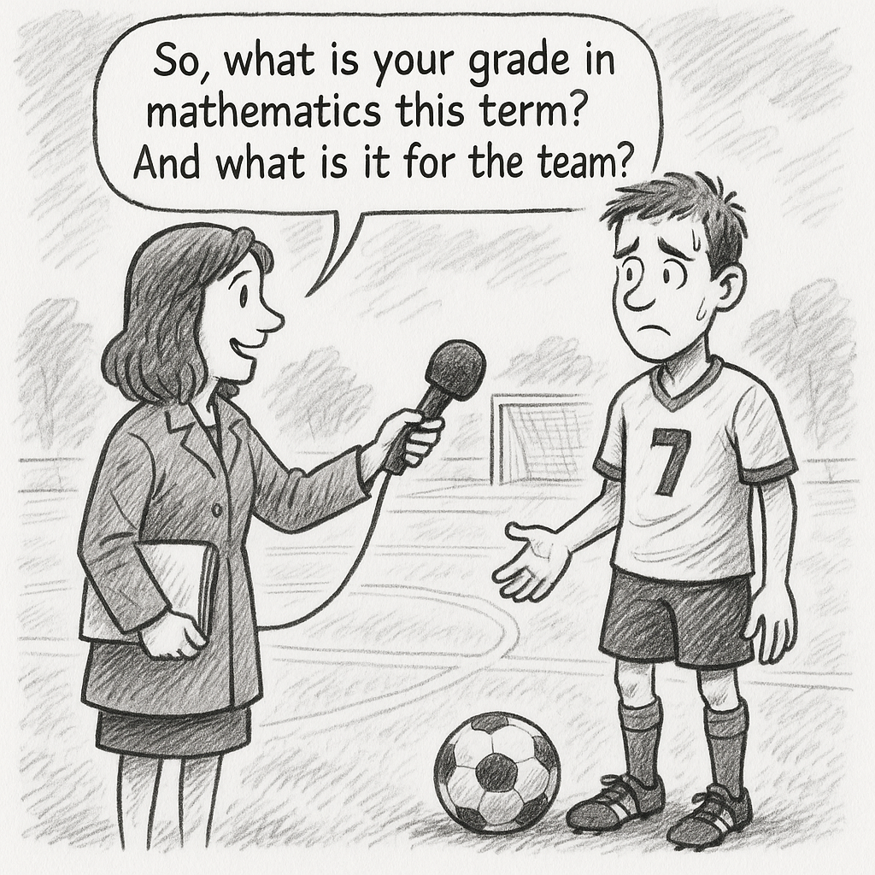
Is it possible to compensate for a poor grade in Math with a good grade in Sports?
As here, so too in the development and marketing of new varieties of arable crops ... you can rarely have ‘everything’, and varieties with the highest yield are rarely those with the best resistance and best quality and highest farmer acceptance and easiest to multiply and giving best seed quality.
In addition, the different features are often un-favourably correlated, for example, yield is often un-favourably correlated with quality (elite baking wheat typically has a lower grain yield than low-baking feed wheat). A default approach to this problem is to calculate an index in which the characters are included with appropriate weights, to focus on the so-called Korrelations-Brecher (‘correlation-breakers’, outliers of correlation).
https://s.gwdg.de/JYTwvv
4

Slide 5
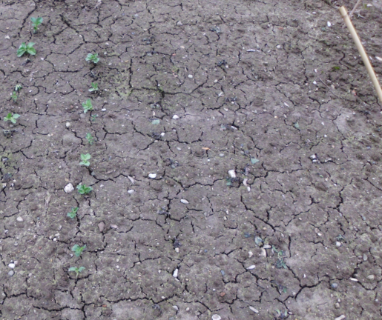
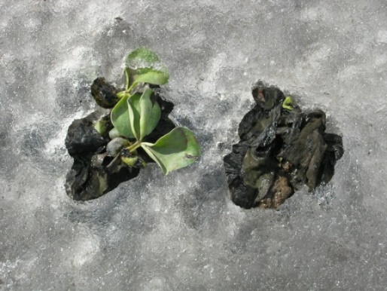
Transition from
● Indirect Selection to
● Index Selection
Indirect Selection (cf. UNPLAB-Indirect_Ch-1[Correlated Gain]) includes a transition to the current topic: Index Selection.
Indirect Selection means: We select on a trait such as Trait X and study the correlated, indirect change of Trait Y. Watch out, selection is only on trait X and Trait Y is ignored, it is not participating in our selection decision.
Take an example. Trait Y is Winter Hardiness, and Trait X is Plant Height in juvenile stage in late autumn. There is a negative correlation between this specific height and winter hardiness (say, r=-0.71; R²=0.50). Types which are stunted before-winter, which slowly gain plant height and which are rather ducking before the coming winter, such types tend to show somewhat higher winter hardiness. Now, in your field trial across several sites, only one site (light soil dry site) showed some winter kill (data on winter-hardiness resulted there; however, that data is not truly representative of the Target Area of Marketing). So your data on winter hardiness is relatively poor, such as h² = 0.1; but data for plant height at juvenile stage in late autumn was fine, you assessed this trait at each site, heritability may be such as h²=0.9. You would select for short types.
If you ignore the doubtful results on winter hardiness Y, then you select solely on plant height X. All weight is on this trait (Trait X, Plant Height).
Next page: Compare this setting (1) phrased as Indirect Selection with
(2) as Index Selection (Optimum-Index: cf. ISBN 978-0-367-23571-0).
Much winter kill in winter faba beans © WL
5

Slide 6

Transition from
● Indirect Selection
to
● Index Selection
Indirect (Correlated) Response is predicted as (cf. UNPLAB-CorrTraits_Ch-2):
${CR}_{Y}=i h_{X} r_{G\left(Y.X\right)}σ_{G\left(Y\right)}$
hence:
CR_{Y} = i ∙ σ_{G}(X)/σ_{P}(X) ∙ ω_{G}(Y.X) / [σ_{G}(Y) ∙ σ_{G}(X)] ∙ σ_{G}(Y)
hence:
CR_{Y} = i ∙ σ_{G}(X) ∙ ω_{G}(Y.X) ∙ σ_{G}(Y) / σ_{P}(X) ∙ σ_{G}(X) ∙ σ_{G}(Y)
hence:
CR_{Y} = i ∙ ω_{G}(Y.X) / σ_{P}(X)
Optimum-Index Algebra predicts R_{Y}, i.e. Response (i.e. Gain) for trait Y as …
R_{Y} = i [b_{Y} ∙ σ²_{G}(Y) + b_{X} ∙ ω_{G}(Y.X) ] / σ_{I}
σ_{I} = square root of the variance of the index values: σ²_{I}
σ²_{I} = [b_{Y} ∙ σ_{P}(Y)]² + [b_{X} ∙ σ_{P}(X)]² + [2 ∙ b_{X} ∙ b_{Y} ∙ ω_{P}(Y.X)];
ω_{P} and ω_{G} are phenotypic and genetic covariances
b_{Y} and b_{X} are the weights for the traits to built the index for each candidate
Here, we say: b_{Y} = 0 and b_{X}= 1
Does not say: “Trait Y is irrelevant”.
But it says: “Trait Y is our target trait, but we select solely on Trait X”.
With this, we come to Predicted R_{Y} = i ∙ ω_{G}(Y.X) ] / σ_{P}(X)
So: We went from Indirect, Correlated response CR_{Y} to the response to Index Selection R_{Y} (with weights b that mimic the indirect response setting).
Well. In the frame of Index Selection, oftentimes if not mostly, we will have some weight on both or on each trait; this, then, is unlike ‘here’.
Much winter kill in winter faba beans © WL
6

Slide 7
Left: Indirect gain of winter hardiness when solely selecting in favour of short juvenile plant height. Right: Selection based on an index. Index gives negative weight for plant height (select for short ones) and positive weight for winter hardiness.
The relatively higher the weight for winter hardiness, the less steep the broken line. Index selection takes the red one, because it seems well winter-hardy although does not belong to the very short ones. If selection were for winter hardiness only (zero weight on plant height), then the blue broken line would be horizontal.
Regression b_{(Y.X)}=0.50
Correlation r_{(X.Y)} =0.71
Data is not real, is just to show the principle.
With real data, the scale must be observed when quantifying the weights. For instance, if winter hardiness was scaled from 0-100, then one scale unit is less 'heavy' than if the scale went from 1-9.
Be aware that assessing both traits is more expensive than assessing one trait only.
Winter Hardiness
Juvenile Plant Height
Juvenile Plant Height
7

Slide 8
Index Selection. When simultaneously working on several traits (traits such as yield and resistance; maybe more than two traits), breeders normally follow their intuition and experience and thus implicitly ‘weigh’ (rather than explicitly, with Algebra).
But: To study and teach, we need explicit weights.
Some of the pertinent questions when selecting on several traits simultaneously:
How easy or costly is it to assess one trait compared to the other traits?
What is the amount of genetic variability in the traits?
Is it practical and appropriate from a breeding scheme point of view to select for these traits at the same time?
What is the heritability of the phenotypic data of the traits? Are these h² values markedly different?
Is there fortunate or unfortunate correlation between the traits, is such correlation due to genetics? If so, can an unfortunate correlation be resolved or ‘broken’?
Is the phenotypic correlation coefficient between the traits presumably impacted by correlated errors and /or correlated GxE terms of the traits?
Will the genetic makeup of the trait allow marker-assisted selection or genomic prediction?
…
For sure more questions exist; I don not know them all and, anyway, we can not deal with all of them.
DOI 10.1007/s10681-007-9507-2
8

Slide 9
Several important questions are still open that need to be answered when it comes to build the so-called Optimum Selection Index
(RJ Baker, ISBN 978-0-367-23571-0).
One such question is for the phenotypic and genetic variances of the traits and the covariances between the traits, which is implicitly asking for the h² values of the traits.
Therefore, we invest a bit into this topic: What is a genetic covariance and correlation, in contrast to a phenotypic covariance and correlation?
9

Slide 10
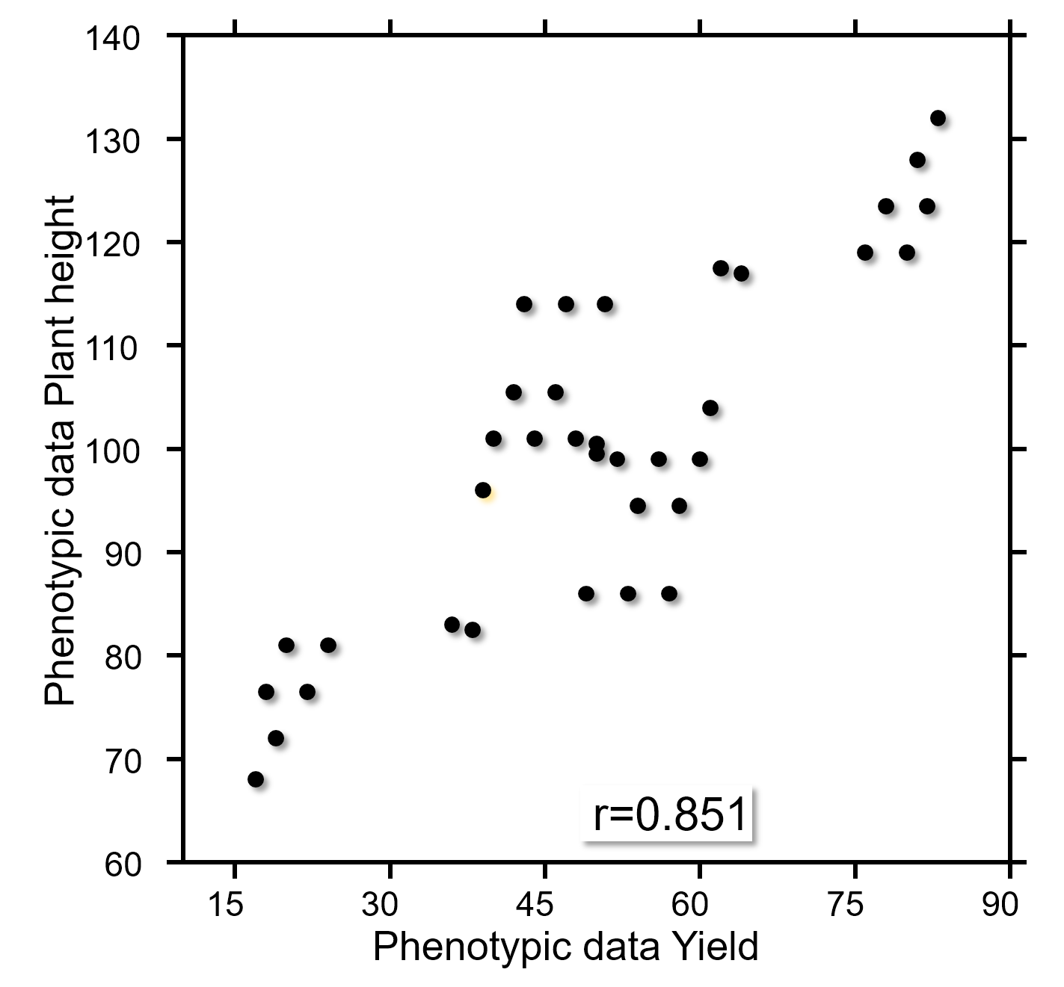
A crucial parameter for index selection is phen. and gen. covariance between traits.
r=0.634
10

Slide 11
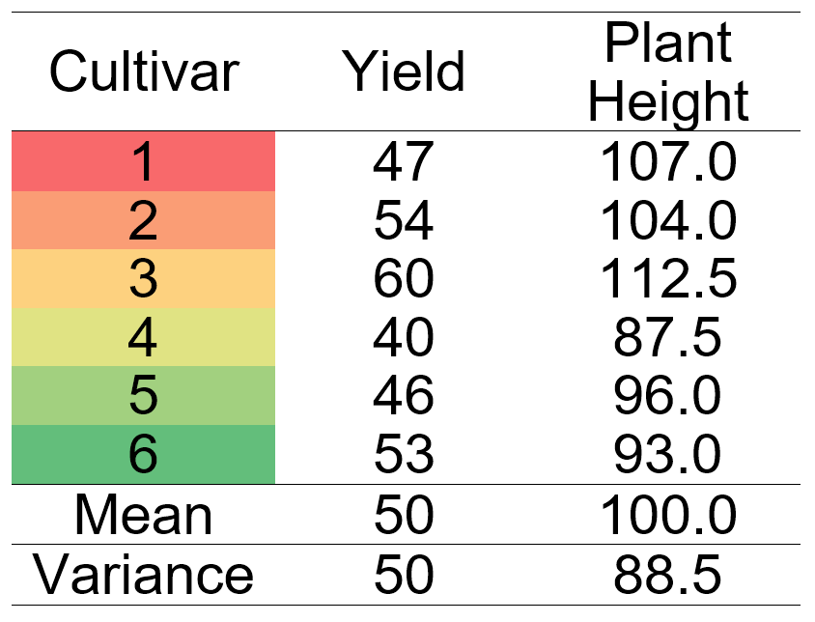
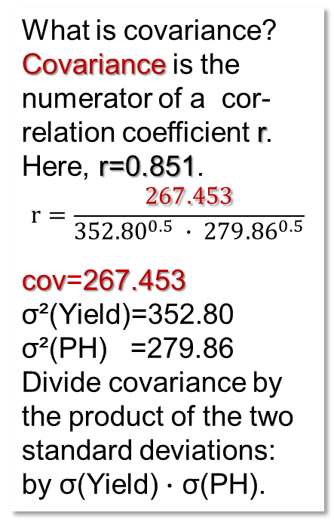
A crucial parameter is the phenotypic and genotypic covariance between traits.
What is covariance?
Covariance is the numerator of a cor-relation coefficient r. Here, r=0.851.
$$r=\frac{267.453}{{352.80}^{0.5} ∙ {279.86}^{0.5}}$$
cov=267.453 σ²(Yield)=352.80 σ²(PH) =279.86
Divide covariance by the product of the two standard deviations:
by σ(Yield) $∙$ σ(PH).
Having indicated what covariance is (“numerator of the correlation coefficient”), we need to see what phenotypic and genotypic covariance may be. Well ….
11

Slide 12
Phenotypic and genotypic covariance between traits.
12
140
See the data from table of last page.
The correlation between the traits is r=0.851:
a confounded result! It is composed from
(1) correlation between the 6 cvs.‘ effects for yield
and plant height (r=0.722),
(2) the correlation between the 6 environmental
effects between the traits (r=0.822), and
(3) the correlation between the GxE effects of the
two traits (r=1.000).
The diagram shows 6 ∙ 6 = 36 dots. See the six red dots, the results of the 6 cvs. at the 1st env. The higher their yield, the taller they tend to be in that envt. One of the six red dots is framed green: The result of Cv. 1 in Env. 1; together with the other green dots, we see here Cv. 1 in the six envs. That correlation is r=0.917, and it is – obviously – non-genetic. The black dots are the results of the other five cvs. in the other envs. The large black dot framed green is the average of Cv. 1 across the six envs. (average of the six green dots).
6 cvs. at first environment
First cv. at six environments
First cv.‘s mean across six envs.
130
120
110
Phenotypic data Plant Height
100
Cv. 1 at
Env. 1
90
80
70
N=36: r=0.851**
60
15
30
45
60
75
90
Phenotypic data Yield

Slide 13
See the first cultivar‘s mean across the six environments bounce in.
The correlation between the means (or effects) of the six cultivars on Yield and on Plant Height was r=0.722. This is a phenotypic correlation; a proxy for the genetic correlation between the two traits.
140
6 Cultivars: r=0.722
130
120
110
Phenotypic data Height
100
90
80
70
60
15
30
45
60
75
90
13
Phenotypic data Yield

Slide 14
See the first environment‘s mean across the six cultivars bounce in.
14
The correlation between the means (or effects) of the six environments on Yield and on Plant height was
r=0.822. This is a proxy of the purely environment-caused correlation between the traits (right diagram).
140
140
6 Cultivars: r=0.722
6 Environments: r=0.822
130
130
120
120
110
110
Phenotypic data Height
Phenotypic data Height
100
100
90
90
80
80
70
70
60
60
15
30
45
60
75
90
15
30
45
60
75
90
Phenotypic data Yield
Phenotypic data Yield

Slide 15
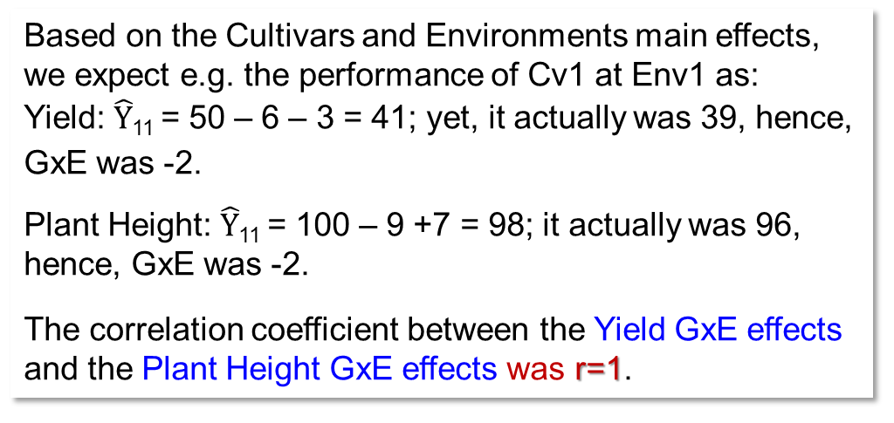
GxE interaction effects for Yield were identical to GxE effects for Plant Height (to make things ‚easy‘) … as if the specific adaptation or mis-adaptation of genotypes to any specific environment resulted in the same GxE effect on Yield and on Plant Height.
Based on the Cultivars and Environments main effects, we expect e.g. the performance of Cv1 at Env1 as:
Yield: $\hat{Y}$₁₁ = 50 – 6 – 3 = 41; yet, it actually was 39, hence, GxE was -2.
Plant Height: $\hat{Y}$₁₁ = 100 – 9 +7 = 98; it actually was 96, hence, GxE was -2.
The correlation coefficient between the Yield GxE effects and the Plant Height GxE effects was r=1.
Correlation coefficient between the effects of the six environments: r = 0.822
Correlation coefficient between the effect of six cultivars (genetic effects): r = 0.722
Having the same GxE effects in both traits is, here, for didactic reasons only. I'm really not saying that this is a must-have or usual or expected outcome.
15

Slide 16
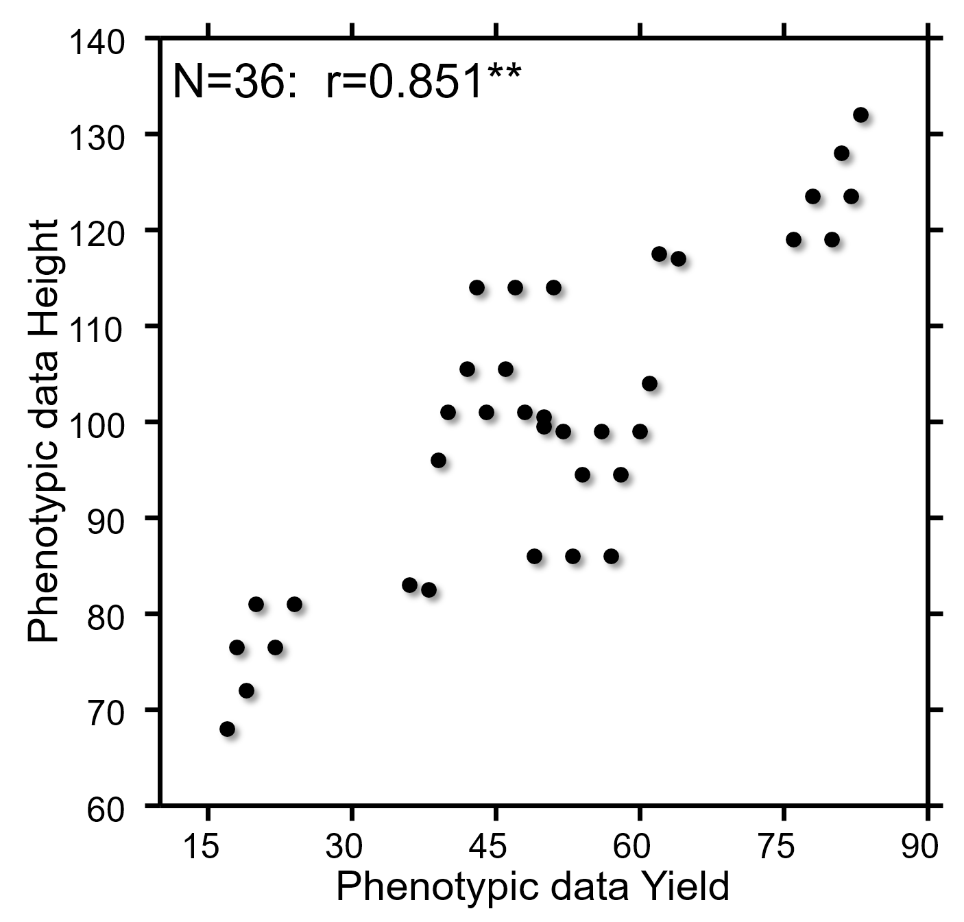
1
Again: The correlation between the 36 GxE effects of our current data set is r=1.0
The blue circle holds the four estimates of GxE=-2 mentioned in the table last page – one of these four is the GxE interaction effect of Cv1 in Env1., as mentioned earlier.
With these three correlations:
r_{due to cvs.} = 0.722
r_{due to envs.} = 0.822
r_{due to GxE} = 1.00 …. we understand that, indeed, …
16
3
… the correlation between the 36 dots here (r=0.851) is a hodgepodge, a mixing and blen-ding of these three values.
We are Plant Breeders. Hence,
in the next pages, we focus on the correlation bet-ween the cvs’. effect on Yield and on Plant Height.
16
r=1.00
r=0.851
3
12
8
3
1
4
3
4
4
GxE-effects of plant Height
0
3
-4
3
Numbers show
1
frequency of
occurrence
-8
3
-12
3
-16
-16
-12
-8
-4
0
4
8
12
16
GxE-effects of Yield

Slide 17
Are the six cvs. Effects phenotypic or genetic?
Cf. UNPLAB-h²_GxE_Ch-1[Broad Sense h²]], page 26 ff.
Cultivar Effects on Yield
-35
-20
-5
5
25
35
140
6 Cultivars: r=0.722
40
Each of the six dots is still ‚contaminated‘ with some GxE effects, because these means are across N=6 envi-ronments (not from N=∞).
This is true for both, Yield and Plant Height.
130
30
120
20
110
10
Phenotypic data Plant Height
Cultivar Effects on Plant Height
100
0
90
-10
80
-20
70
-30
60
-40
15
30
45
50
60
75
90
Phenotypic data Yield
The variance between these cvs’ results is phenotypic; it contains expectedly 1/6 of the σ²_{GxE} (both traits).
The same is true for the covariance cov_{Y,PH}, which is phenotypic and ‚contaminated‘ with 1/6 of the cov_{GxE(Y,PH)}.
Therefore, r=0.722 is a phenotypic correlation coefficient.
17

Slide 18
Are the six cvs. Effects phenotypic or genetic?
Cf. UNPLAB-h²_GxE_Ch-1[12E36G], page 26 ff.
Cultivar Effects on Yield
-35
-20
-5
5
25
35
140
6 Cultivars: r=0.722
40
Each of the six dots is still ‚contaminated‘ with some GxE effects, because these means are across N=6 envi-ronments (not from N=∞).
This is true for both, Yield and Plant Height.
130
30
120
20
110
10
Phenotypic data Plant Height
Cultivar Effects on Plant Height
100
0
90
-10
80
-20
70
-30
60
-40
15
30
45
50
60
75
90
Phenotypic data Yield
The variance between these cvs’ results is phenotypic; it contains expectedly 1/6 of the σ²_{GxE} (both traits).
The same is true for the covariance cov_{Y,PH}, which is phenotypic and ‚contaminated‘ with 1/6 of the cov_{GxE(Y,PH)}.
Therefore, r=0.722 is a phenotypic correlation coefficient.
18

Slide 19
Let us estimate the genetic correlation coefficient between Yield and Plant Height
Reminder: The variance components for the (source of variation called) “Cvs.” is calculated as ► 15.44 =(300.00-207.36)/6. Luckily, MS(Cvs) is larger than MS(GxE) (300.00<207.36); otherwise we would assume there was no genetic variance. 6 is the number of environments - each mean of a cv. contains the mean of 6 GxE interaction effect of this cv. whith these 6 environments. Alles klar?
$$r=\frac{cov(Y;PH)}{{Var(Y)}^{0.5} ∙ {Var(PH)}^{0.5}}$$
Correlation coefficient
Instead of employing the phenotypic parameters for covariance and variance to estimate the phenotypic correlation coefficient, we us their genetic counterparts. So ...
instead of
we calculate
The phenotypic correlation was obviously biased upwards by the positive correlation between GxE of Y and GxE of PH.
$r=\frac{48.00}{{50}^{0.5} ∙ {88.50}^{0.5}}$ = 0.722 = phenotypic correlation
$r=\frac{13.44}{{15.44}^{0.5} ∙ {53.94}^{0.5}}$ = 0.466 = genet. correlation
19

Slide 20
Let us estimate the genetic* correlation coefficient between Yield and Plant Height.
*I probably do not make a sufficiently clear distinction between genetic and genotypic; alas.
https://s.gwdg.de/DT1ZiC
With this, we get a first impression about the genetic (genotypic) correlation coefficient.
A positive correlation of the masking effects (here: GxE) tends to inflate the phenotypic correlation.
The genetic correlation impacts the phenotypic correlation more, if h² of the two traits is high. If it is low, then the correlation of the GxE effects has higher influence on the phenotypic correlation.
Phenotypic correlation between Yield and Plant Height: r=0.722
Genetic correlation between Yield and Plant Height: r=0.466
20

Slide 21
Let us estimate the genetic correlation coefficient between Yield and Plant Height.
21
What if r_{GxE}(YxPH) was zero?
Then r_{G}(YxPH) > r_{P}(YxPH), because the product [(h²_{Y})^{½} (h²_{PH})^{½}] will be smaller than 1. Only if both heritabilities (Y and PH) are h²=1 (and the GxE still uncorrelated) ... then r_{P}(YxH) is not smaller but same size as r_{G}(YxH).
Again: To have r_{G}(YxH) > r_{P}(YxH), we do not need a positive correlation of r_{GxE}(YxPH). We will have this result e.g. with zero correlation, at least as long as h²<1.
Estimates of r_{G} can – even – be larger than r=1 (strange enough).
As soon as the product [(h²_{Y})^{½} (h²_{PH})^{½}] is smaller than the phenotypic correlation (still GxE uncorrelated), we will have r_{G}(YxH) > 1.
Although I stop here, I can see that there is more to gain with due and deeper inspection of this topic. It is you to continue ;-)

Slide 22
GxE interaction effects being highly correlated. How could this happen ?
22
3
An easy explanation would be that the genotypes and environments that make your ‚representative‘ sample were not really representative. This can easily happen in case of a limited number of genotypes and environments.
Click and see. In the basic pool of genotypes and environments, the correlation between GxE of the first trait and second trait may be exactly r=0. Yet, if you chose an unfortunate (non-representative) sample, you may end up with the black GxE effects alone and miss the greyish pairs of effects; hence, you would see the correlation r=1. A real case may be less extreme, still, may be you get r ≠ 0.
Here, the assumption is that – honestly and in the basic pool – the correlation between the GxE effects of the traits was r=0 but not so in your data set.
16
3
12
8
3
1
4
3
4
GxE-effects of plant Height
4
0
3
-4
3
-8
1
3
-12
3
-16
-16
-12
-8
-4
0
4
8
12
16
GxE-effects of Yield
What I haven't really thought about and worked out in depth is: It is not the GxE-effects ‘themselves’ which are sampled from the basic pool (and maybe we ended up with a non-representative sample of them). No. We don’t know the true GxE-effects, hence can not sample them! Instead, we estimate them from our (limited) experiments. The GxE effects and their correlations between two traits – estimated from a sample of genotypes and environments – will differ from their true (unknown) counterparts, and so will the correlation between the GxE of two traits.
As mentioned earlier, there is a fine, silky-thin line between truth and estimated value, and I am not a mathematician. So, think for yourself ;-)

Slide 23
GxE interaction effects being highly correlated. How could this happen ?
23
3
An easy explanation would be that the genotypes and environments that make your ‚representative‘ sample were not really representative. This can easily happen in case of a limited number of genotypes and environments.
Click and see. In the basic pool of genotypes and environments, the correlation between GxE of the first trait and second trait may be exactly r=0. Yet, if you chose an unfortunate (non-representative) sample, you may end up with the black GxE effects alone and miss the greyish pairs of effects; hence, you would see the correlation r=1. A real case may be less extreme, still, may be you get r ≠ 0.
Here, the assumption is that – honestly and in the basic pool – the correlation between the GxE effects of the traits was r=0 but not so in your data set.
16
3
12
8
3
1
4
3
4
GxE-effects of plant Height
4
0
3
-4
3
-8
1
3
-12
3
-16
-16
-12
-8
-4
0
4
8
12
16
GxE-effects of Yield
Could it be we have a true correlation between GxE of two traits? Not ‚just‘ because of sampling issues?
Example. Yield & Quality. Two regions: One with drought, one is humid. Genotypes vary for early vigour.
Genotypes with strong early vigour are drought tolerant. Under drought: Normal yield, normal quality.
Genotypes with strong early vigour. Under humid conditions: Tall, lodging, lower yield, lower quality.
Genotypes with weaker early vigour are drought susceptible. Under drought: Lower yield, lower quality.
Genotypes with weaker early vigour are non-lodging. Under humid conditions: Normal yield, normal quality.
This pattern creates a strong, positive correlation between GxE of Yield and Quality! Even if the main effects of genotypes and environments on the two traits are uncorrelated .

Slide 24
From here you may go to UNPLAB-CorrTraits_Ch-3[IndexSel]
24
24

